Slide 1



Classify Depressive Tweet Using Machine Learning Tools

Slide 2


Introduction
Depression is a mental health disorder that affects millions of people. Globally, an estimated 5% of adults suffer from depression.
Social media platforms such as Twitter provide an outlet for individuals to express their emotions and thoughts publicly.
Using machine learning tools to identify depressive tweets could allow for targeted interventions and support.

Slide 3
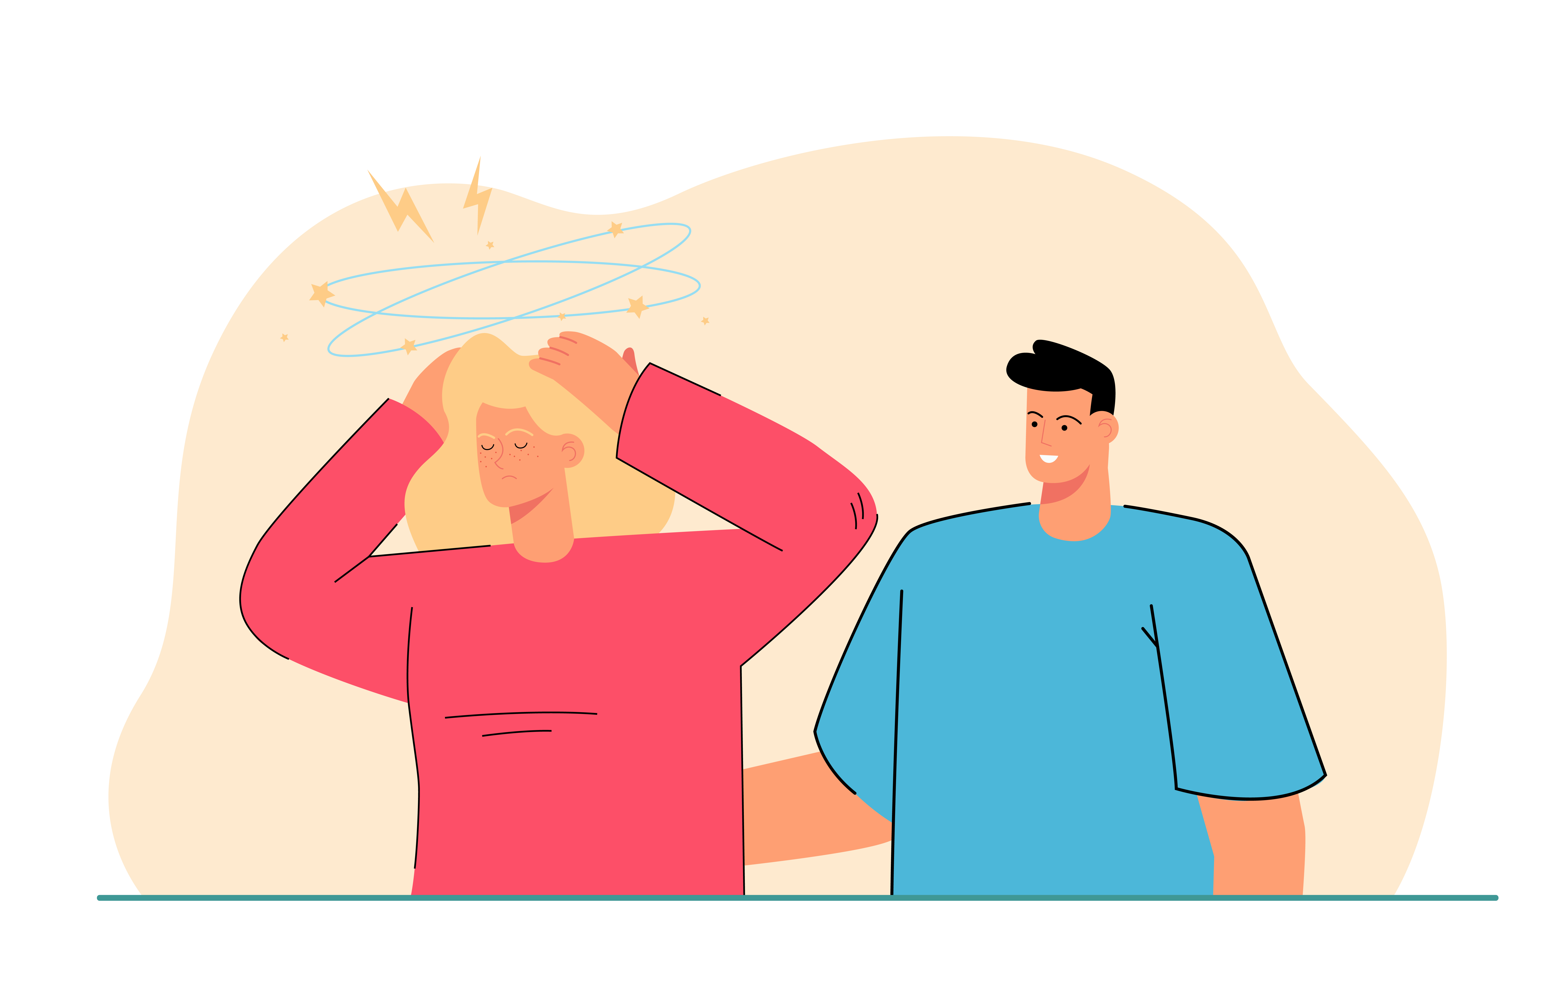
Motivation
Lack of awareness and knowledge of the symptoms can make it challenging to seek professional help.
Machine learning tools could provide a non-invasive and easily accessible way.
Help find depressive symptoms early.
Encourage those social media platform like Facebook, TikTok, Instagram add automatically detection tool.

Slide 4
Related Work
Early works like Nadeem et al.(2016) used statistical classifiers to estimate the risk of depression, achieved about 86% accuracy.
Mowery et al.(2016) developed classifiers to detect depressive symptoms from tweets.
Other methods used like fine-tuned models by Rizwan et al.(2021) and Lin et al.(2020) combined CNN and BERT to use both visual and textual content.
I will explore more on Information processing, deep learning model, and web application build.

Slide 5
Methodology
NLP tools like NLTK to do tweet text process.
TF-IDF to extract tweet features.
Compare traditional classifiers like Logistic Regression, KNN, SVM and Random Forest.
If necessary, LSTM or fine-tuned model like BERT to improve the performance.
Python Flask for backend server, React for frontend UI.

Slide 6
Reference
World Health Organization. "Depression." World Health Organization. https://www.who.int/news-room/fact-sheets/detail/depression.
Nadeem, M., Horn, M., Coppersmith, G., Hopkins University, J., & Sen, S. (2016). Identifying Depression on Twitter.
Mowery, D., Park, A., & Bryan, C. (2016). Towards Automatically Classifying Depressive Symptoms from Twitter Data for Population Health. http://liwc.wpengine.com/
Lin, C., Hu, P., Su, H., Li, S., Mei, J., Zhou, J., & Leung, H. (2020). SenseMood: Depression detection on social media. ICMR 2020 - Proceedings of the 2020 International Conference on Multimedia Retrieval, 407–411. https://doi.org/10.1145/3372278.3391932
Rizwan, M., Mushtaq, M. F., Akram, U., Mehmood, A., Ashraf, I., & Sahelices, B. (2022). Depression Classification From Tweets Using Small Deep Transfer Learning Language Models. IEEE Access, 10, 129176–129189. https://doi.org/10.1109/ACCESS.2022.3223049

Slide 7
Methodology
Collect Normal Tweet (Label 0)
Text Processing
Classification Models
Web Application
Collect Depressive Tweet (Label 1)

Slide 8
Data Collection
Normal Tweet come from the Sentiment140 dataset https://www.kaggle.com/datasets/kazanova/sentiment140, randomly pick 60,000 tweet.
Depressive Tweet come from https://github.com/miladrezazadeh/twitter_depression_detection/blob/main/data/processed/processed_data.csv, which is a separate dataset of tweets that had been scraped by public Twitter API using keywords related to depression.
Merge and Shuffle two dataset, Normal Tweet with label 0, Depressive Tweet with label 1.

Slide 9
Text Processing
Input Text : Hey @username, check out this amazing #AI model! It's capable of understanding and generating text, isn't that awesome? Find more info at: https://www.example-ai.com/ 🚀
Output Text : hey check amazing ai model capable understanding generating text awesome find info
TF-IDF vectorizer : 67317x10000 sparse matrix

Slide 10
Classification Models
Traditional Classifiers : Logistic Regression, Support Vector Machine, K-Nearest Neighbors Algorithm, Random Forests. Except KNN, all achieved good performace (More than 95%).
Deep Learning Model : Long Short Memory
Pre Trained Model : BERT, BERT could classify 2000 tweet in 100% correct.

Slide 11
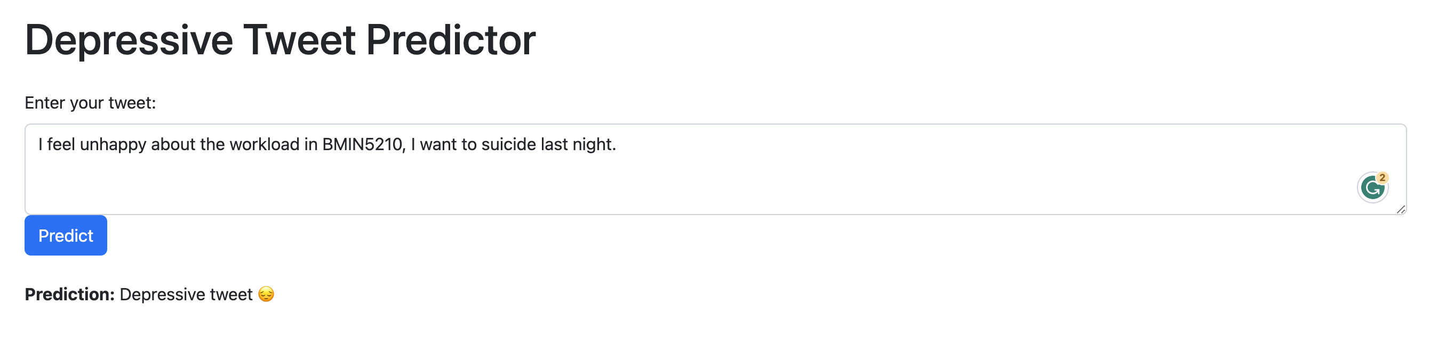
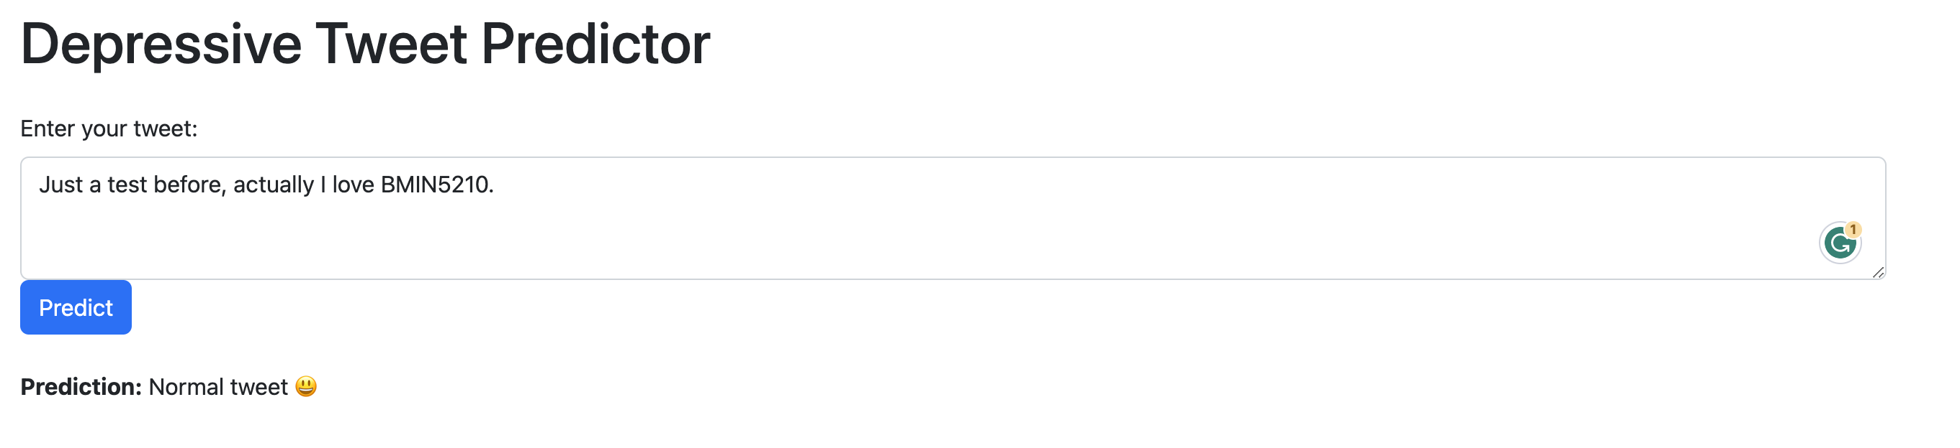
Web Application

Slide 12
Results Of My Work

Slide 13
Two Steps Data Filter
Zero shot classification model (bart-large-mnli)
Depressive Tweet (Label 1)
TextBlob Sentiment Analysis (19.8% left)
Filtered Depressive Tweet (18.6% left)

Slide 14
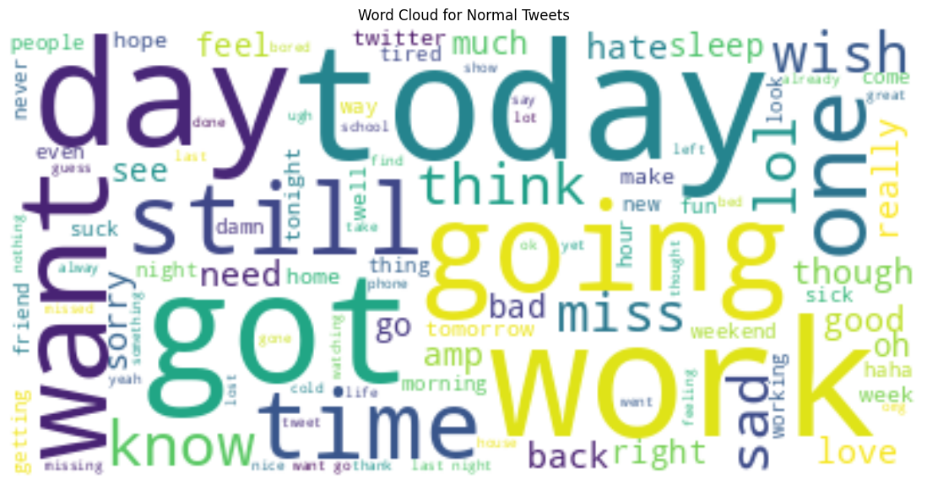
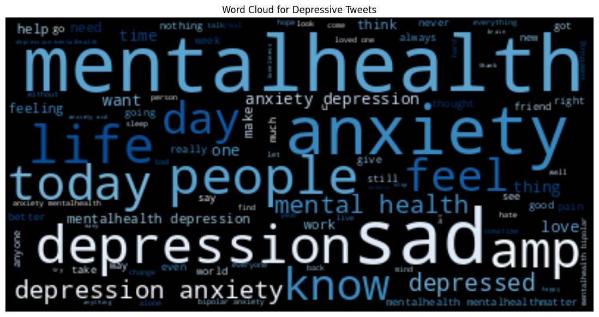
Word Cloud
Normal Tweet
Depressive Tweet

Slide 15
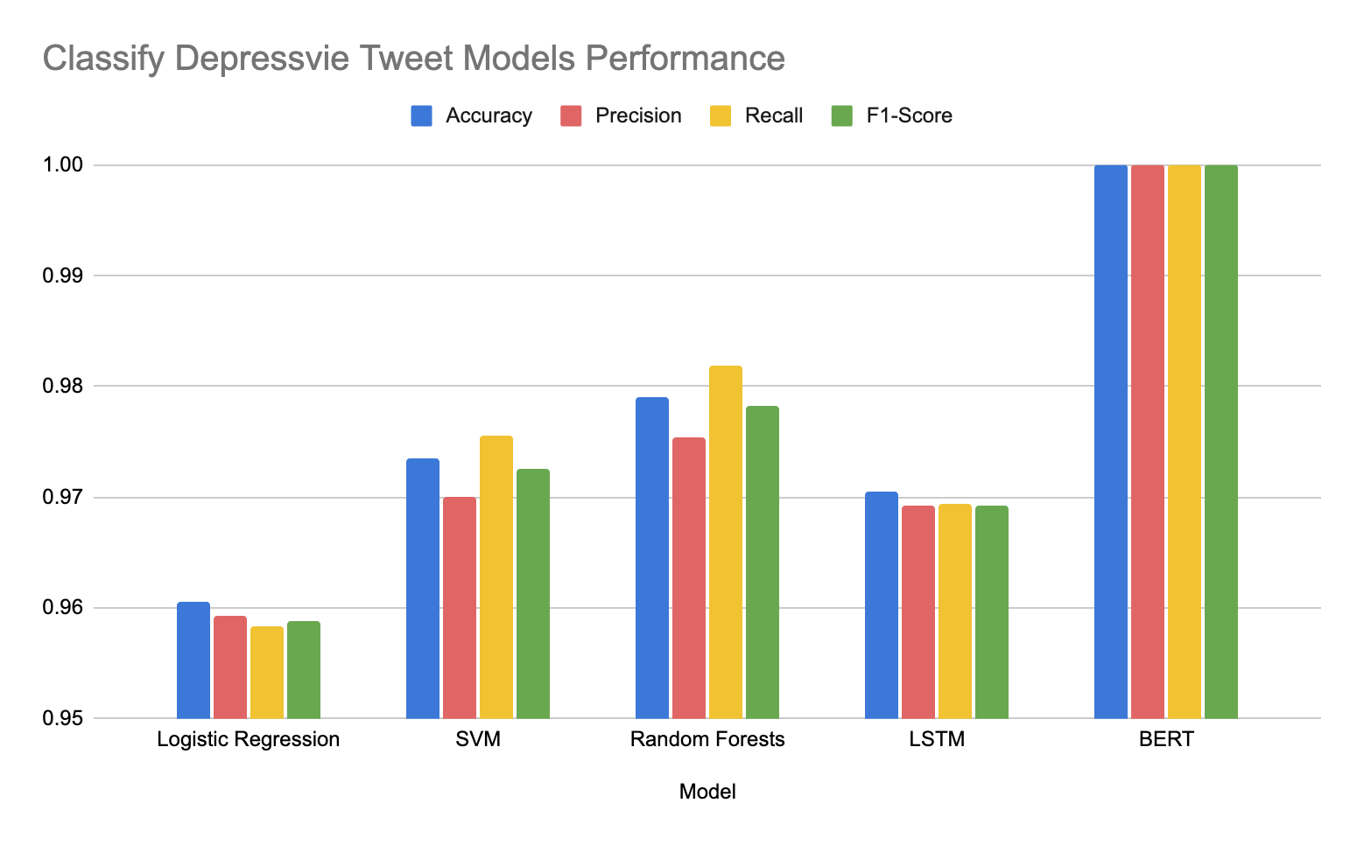
Model Performance

Slide 16
Results Analysis
“Success” of BERT
Pre-trained with huge text content
Advanced architecture
Self-attention mechanisms
“Failure” of LSTM
Drawback of depressive dataset -> simplify the classification task
May achieve better performance in on a less obvious dataset
Notes:
In our analysis, BERT, a state-of-the-art transformer-based model, demonstrated exceptional performance in classifying depressive tweets, achieving a perfect accuracy of 100%. The model's outstanding precision, recall, and F1-score metrics underline its ability to accurately and consistently distinguish between depressive and non-depressive tweets. The success of BERT can be attributed to its innovative architecture, which leverages bidirectional context from the input text and utilizes self-attention mechanisms to capture long-range dependencies. In comparison to other methods, such as LSTM and traditional classifiers, BERT exhibits superior performance in this classification task, showcasing its potential for detecting early signs of depression in social media data and advancing mental health research.
The performance of LSTM in our analysis, although competitive, did not surpass that of traditional classifiers like SVM and Random Forest. A possible reason for this outcome could be the nature of our dataset, which was collected using specific keywords, potentially simplifying the classification task. This might have allowed traditional classifiers to achieve high accuracy without considering the context provided by word order. We hypothesize that LSTM might demonstrate superior performance on a more diverse and less obvious dataset, such as tweets from users diagnosed with depression by medical professionals. In such cases, the emotional content of the tweets may be more subtle, and the context derived from word order might become crucial for accurate classification. This would likely emphasize the advantages of LSTM over traditional classifiers in handling complex text data, highlighting its potential for detecting early signs of depression in social media.

Slide 17
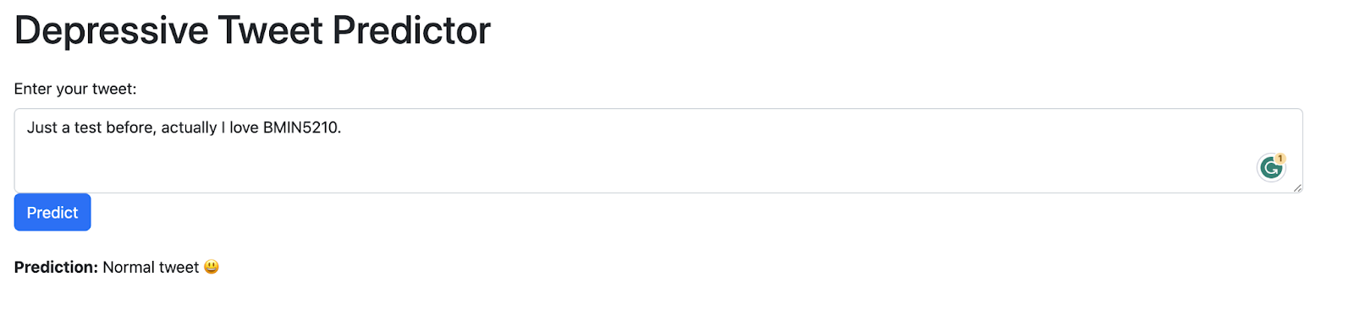
Future Exploration
Dataset like tweet posted by “real” depressive user
Combine text content with other information as figure, video
Encourage Social Platform add auto-detect function

